Slide 1
4 Corner Debate

Slide 2
4 Corner Debate Your Topic of Debate
Kids younger than 18 years of age
should be able to make their own decisions about whether to get
body piercings or tattoos.

Slide 3
4 Corner Debate Rules
Display the poster bullet points for the Strongly Agree, Agree, Disagree, & Strongly Disagree teams.
One representative from each side of the argument takes turns presenting their team’s position on the respective debate question.
It is the goal of each team’s representative, to logically and pragmatically persuade others to embrace their position, by doing a good job of arguing as to how they came to their conclusions on the question.

Slide 4
4 Corner Debate Terminology
logically – adj: capable of reasoning or of using reason in an orderly cogent fashion.
cogent – adj: appealing forcibly to the mind or reason.
pragmatically - relating to matters of fact or practical affairs often to the exclusion of intellectual or artistic matters : practical as opposed to idealistic.

Slide 5
4 Corner Debate Let The Arguments Begin!

Slide 6
4 Corner Debate Your Grade Counts!
Write a five paragraph response using your bullet points (index card)
State your position on the issue (question we are debating)
Your paragraph should begin like this:
I ______________ with the statement ________________ because of the following reasons.
My (T. W.) reason is that _______________________________________________________
_________________________. (T. W.), __________________________________________.
(T. W.), _____________________________________________________________________
__________________________________________________________________________.
(T.W.), _____________________________________________________________________
__________________________________________________________________________.
In conclusion ________________________________________________________________
___________________________________________________________________________
__________________________________________________________________________.

Slide 7
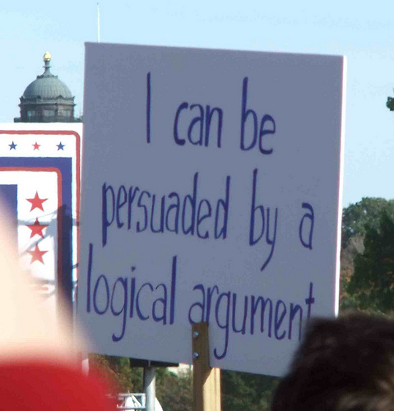
4 Corner Debate What was the most important debate concept implemented during this exercise?

Slide 8
4 Corner Debate Which Position Won?

