Slide 1
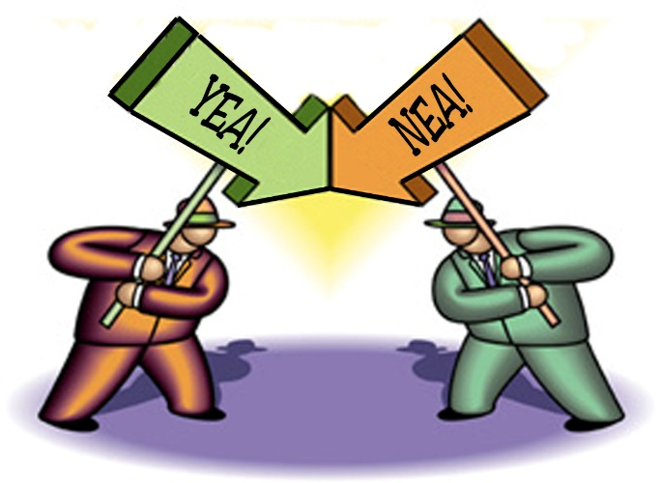
4 Corner Debate

Slide 2
4 Corner Debate I. B., A. T. L.’s
Thinking skills
Social “ “
Communication “ “
Collaboration “ “
Self-management “ “

Slide 3
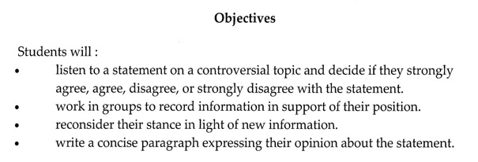
4 Corner Debate Objectives

Slide 4
4 Corner Debate Textbook Concepts Previously Studied
Debate classification is …
informal
2.Skills gained from this exercise are …
Collaboration
Inquiry

Slide 5
4 Corner Debate - Textbook Concepts Previously Studied, cont.
c.Listening
d.Presenting
e.Professionalism
f. Reading
g.Respect
h.Speaking

Slide 6
4 Corner Debate Supplies Required Today
Pencil / pen
Index card – supplied by Mr. Katz

Slide 7
4 Corner Debate Assessment Specifics
1 grade for equal participation.
“ “ for turning in your index card w/discussion bullet-point notes.
“ “ for submission of
a 5-sentence response stating your position on the issue.

Slide 8
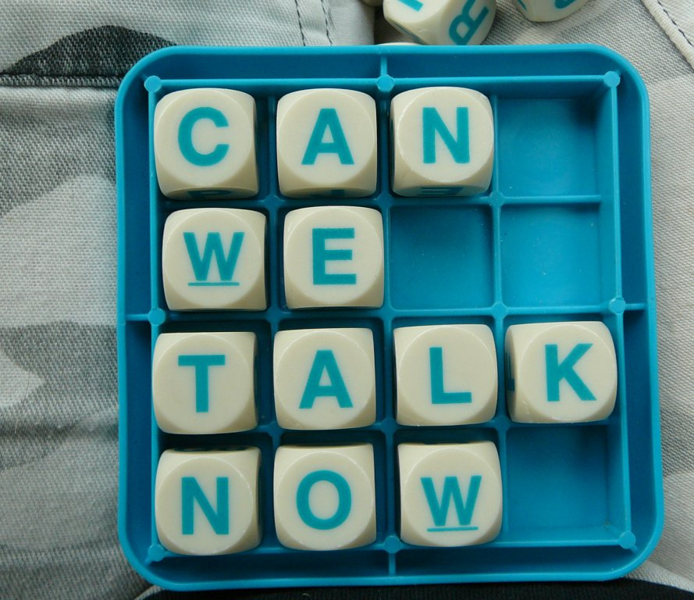
4 Corner Debate Possible Discussion Topics?

Slide 9
4 Corner Debate Your Argument

Slide 10
4 Corner Debate Format / Task
1.Move to the corner of the room where you collaborate with fellow scholars who have similar views of the topic in question:
Strongly agree
Agree
Disagree
Strongly disagree

Slide 11
4 Corner Debate - Format / Task, cont.
2.Construct an argument to be presented to the three other groups.
3.One representative from each group speaks as to their group’s position.
4.Students listen to the other group’s arguments, and decide as to if they desire to another group if they are persuaded to do so.

Slide 12
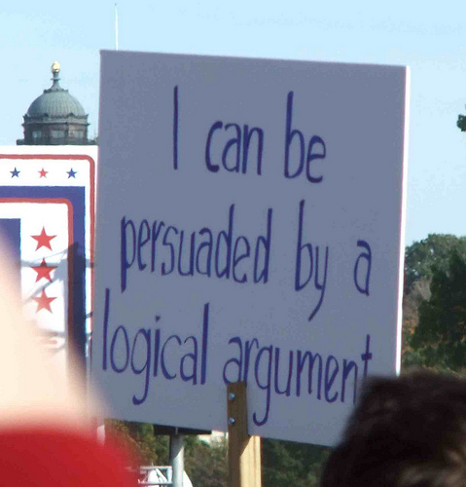
4 Corner Debate What was the most important debate concept implemented during this exercise?

